Slide 1
DIGITIALIZATION PRINCIPLES
Dr. Quang Duc Tran

Slide 2
Analog Signals
As mentioned earlier the amplitude of the signal varies continuously with time
The Fourier transform decomposes a signal into the frequencies that make it up
The Fourier analysis can be used to show that any time varying signal is made up of infinite number of single-frequency sinusoidal components

Slide 3
Analog Signals (Cont.)
A band-limited signal x(t) is one whose Fourier Transform is non-zero on only a finite interval of the frequency axis.
There exists a positive number B such that X(f) is non-zero only in -B≤f≤B. B is called the signal bandwidth.
Speech bandwidth: 100Hz – 4kHz
Music Bandwidth: 15Hz – 20kHz
To transmit an analogue signal through a network the bandwidth of the transmission channel should be equal to or greater than the signal bandwidth.

Slide 4
Digital Audio Recording Chain

Slide 5
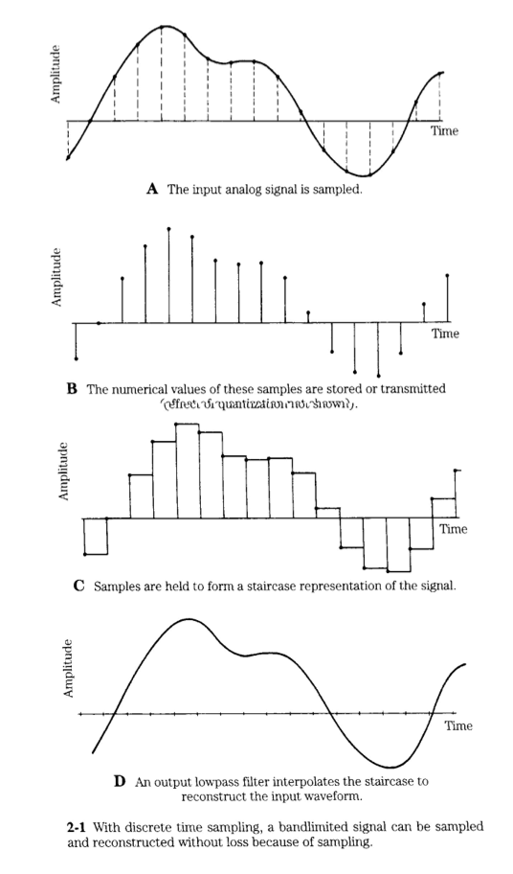
Digital Audio Recording Chain

Slide 6


Fourier Transform
The Fourier Transform is an operation that transforms data from the time domain into the frequency domain.
Forward Fourier Transform:
Inverse Fourier Transform:
$$X(w)=\int_{−∞}^{∞}{x(t)e^{−jwt}dt}$$
$$x(t)=\frac{1}{2π}\int_{−∞}^{∞}{X(w)e^{jwt}dw}$$

Slide 7
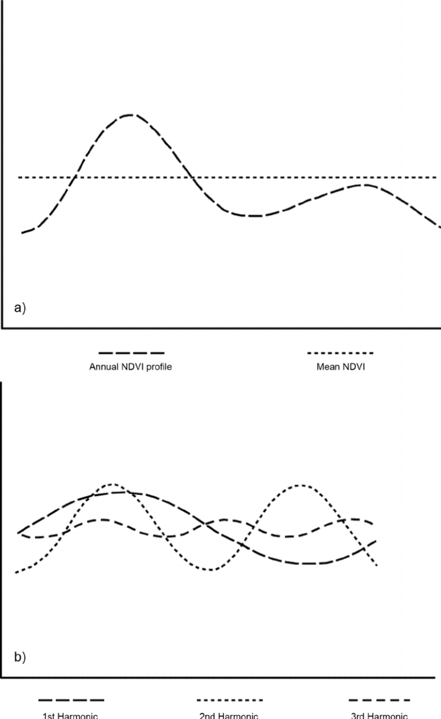
Fourier Transform (Cont.)
What frequencies are present in the signal and in what proportions. The Fourier Transform decomposes a waveform into sinusoids. Waveforms are not made up of a discrete number of frequencies, but rather a continuous range of frequencies.

Slide 8
SAMPLING
Dr. Quang Duc Tran

Slide 9
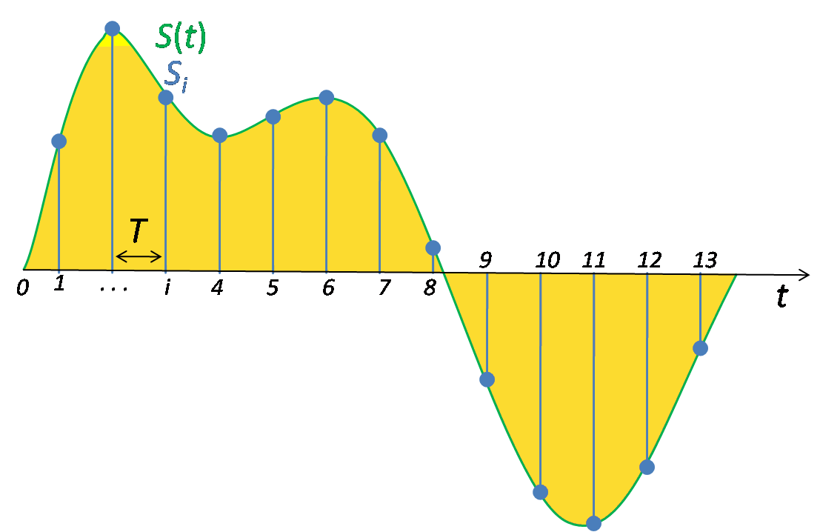
Sampling (Signal Processing)
In signal process, sampling is a reduction of a continuous-time signal to a discrete-time signal.
The sampling frequency or sampling rate (i.e., f_{s}) is the average number of samples obtained in one second.

Slide 10
Sampling Rate
Nyquist theorem: If x(t) is a band-limited signal containing no frequencies higher than B. A sufficient sampling rate (i.e., f_{s}) is 2B or anything larger. 2B is called the Nyquist rate.
Nyquist rate is represented either in Hz or more correctly in samples per seconds

Slide 11
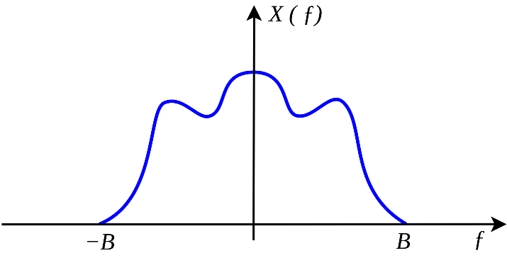




Sampling Rate (Cont.)
T_{s} = Sampling period
$$S(w) =\frac{1}{2π}[X\left(w\right)∗C\left(w\right)]$$
$$S(w) =\frac{1}{2π}[X\left(w\right)∗w_{s}\sum_{n=−∞}^{∞}{δ(w−nw_{s})}]$$
$$S(w) =\frac{1}{T_{s}}[X\left(w\right)∗\sum_{n=−∞}^{∞}{δ(w−nw_{s})}]$$
$$S(w) =\frac{1}{T_{s}}[\sum_{n=−∞}^{∞}{X(w−nw_{s})}]$$

Slide 12
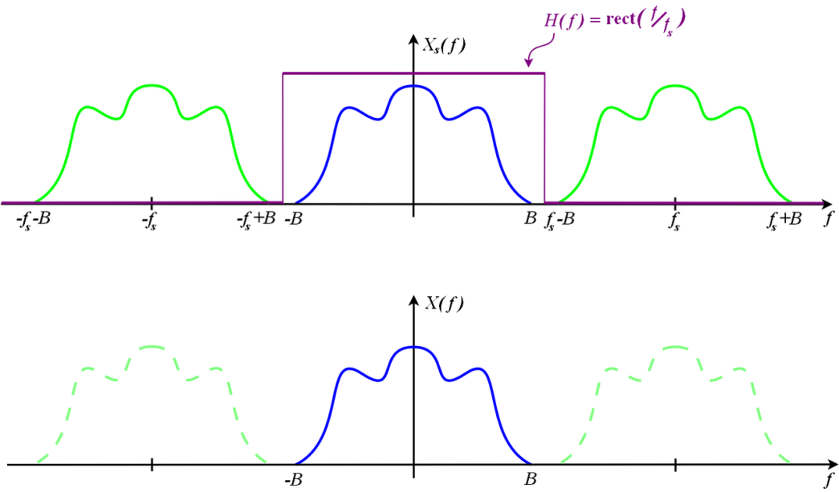
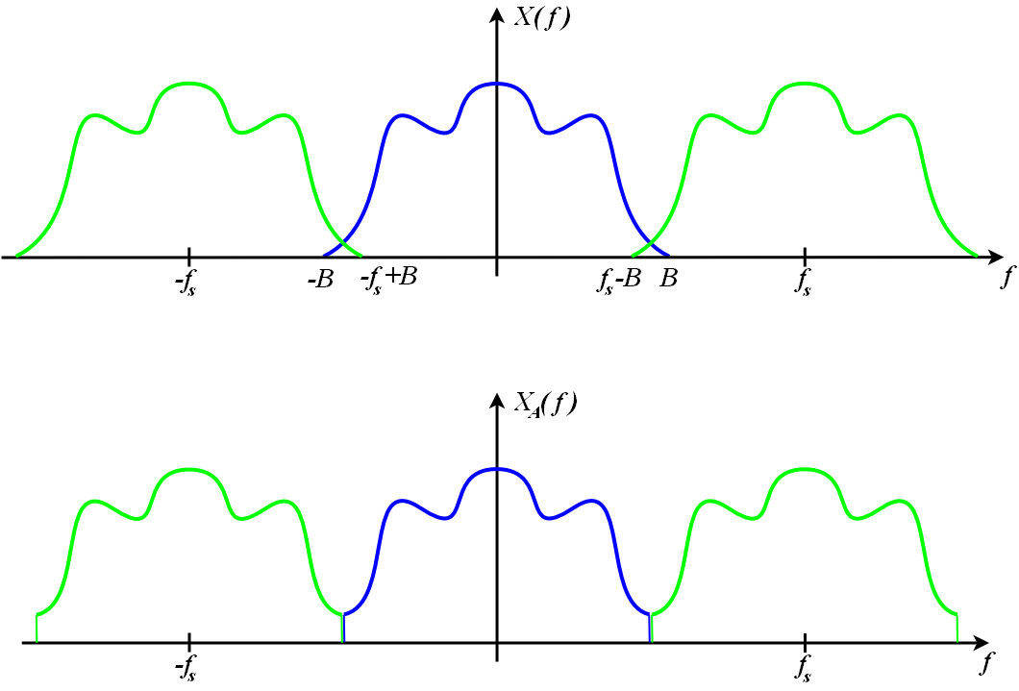
Sampling Rate (Cont.)
For a band-limited signal (X(f) = 0 for all |f|≥B), and f_{s}≥2B, it is possible for the copies to remain distinct from each other. But when the Nyquist criterion is not satisfied, adjacent copies overlap. Any frequency component above f_{s}/2 is indistinguishable from a lower-frequency component, called an alias.

Slide 13
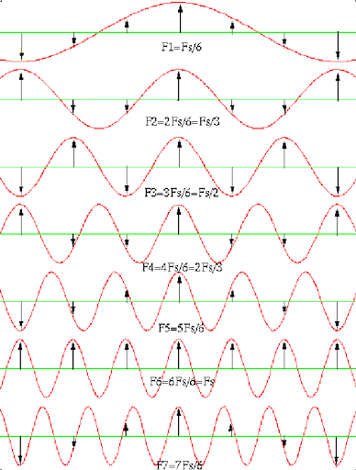
Sampling Rate (Cont.)

Slide 14
QUANTIZATION
Dr. Quang Duc Tran

Slide 15
Data Representation
The most significant bit of the codeword represents the sign of the sample.
A binary 0 indicates a positive value and a binary 1 indicates a negative value.
The signal must be sampled at a much higher rate than the maximum rate of change of the signal amplitude.
The number of quantization levels should be as large as possible to represent the signal accurately

Slide 16
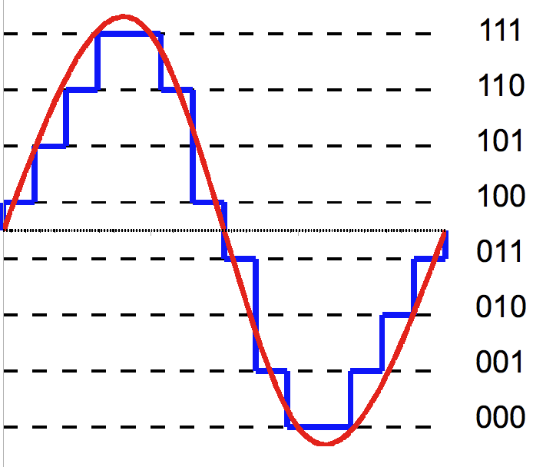
Quantization
Quantization is the process of mapping an analogue value to a number of digits
Three bits are used to represent each sample (1 bit for the sign and two bits to represent the magnitude)
If V_{max} is the maximum positive and negative signal amplitude and n is the number of binary bits used then the quantization interval, q, is defined as
q = V_{max}/2^{n}

Slide 17
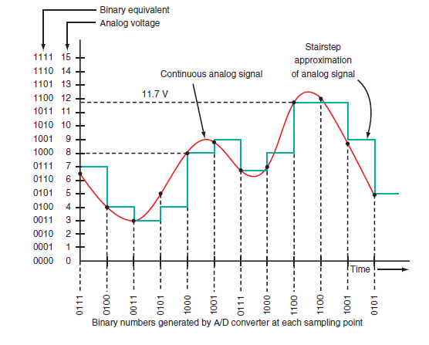
Quantization Error
Each sample is rounded off to closest available level and then converted to its correspondence PCM code.

Slide 18
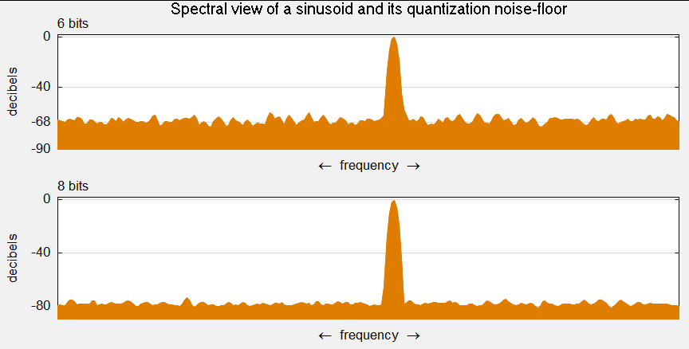
Quantization Error (Cont.)
Quantization error is the difference between the actual signal amplitude and the corresponding nominal amplitude. Consequently, a difference of ±q/2 from the actual signal level is present. Quantization error is also known as quantization noise since values vary randomly
SQNR = 6.02 x n (dB)
SQNR = 1.761+ 6.02 x n (dB)

Slide 19
SNR and Audio Bit Depth
#bits | SQNR | Possible integer values
4 | 24 dB | 16
8 | 48 dB | 256
11 | 66 dB | 2048
12 | 72 dB | 4096
16 | 96 dB | 65.536
18 | 108 dB | 262.144
20 | 120 dB | 1.048.576
24 | 144 dB | 16.777.216
32 | 192 dB | 4.294.967.296

Slide 20
ENCODER AND DECODER DESIGN
Dr. Quang Duc Tran

Slide 21
Encoder Design
The encoder consists of AAF (Anti-Aliasing Filter) and an Analogue-to-Digital Converter (ADC)
Analog
Signal
AAF
Sample and Hold
Quantizer
Digital
Codeword
ADC

Slide 22
Encoder Design (Cont.)
Anti-Aliasing Filter (AAF) removes the selected higher frequency components from the source signal.
Sample and Hold samples amplitude of the filtered signal at regular intervals and holds the sampled amplitudes between samples.
Quantizer converts the samples into their corresponding binary form

Slide 23
Aliasing
Actual signals have a finite duration and their frequency content has no upper bound. Some amount of aliasing always occurs when such functions are sampled.
Aliasing can occur in time, e.g., digital audio (temporal aliasing) and in spatially sampled signals, e.g., digital images (spatial aliasing).

Slide 24
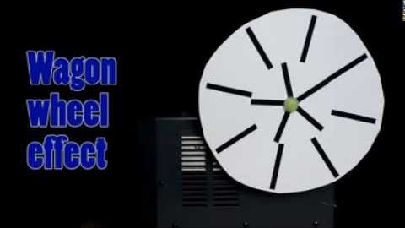
Wagon-wheel effect

Slide 25
Anti-Aliasing Filter
An Anti-Aliasing Filter (AAF) is a filter used before a signal sampler to restrict the bandwidth of a signal to approximately satisfy the Nyquist-Shannon sampling theorem
AAF is often a low-pass filter. However, for signals that are bandwidth limited, but not centred at zero, a band-pass filter can be used.

Slide 26
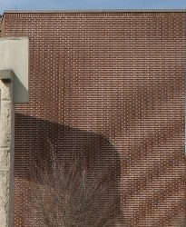
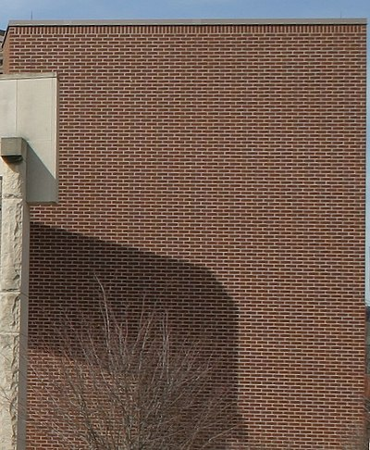
Anti-Aliasing Filter (Cont.)
Simulated photographs of a brick wall without and with an optical low-pass filter

Slide 27
Anti-Aliasing Filter (Cont.)
One designed to sample an FM radio broadcast centred at 87.9 MHz and bandlimited to a 200 kHz band, then an appropriate anti-aliasing filter would be centred on 87.9 MHz with 200 kHz bandwidth. Sampling rate would be no less than 400 kHz.
For most phonemes, almost all of the energy is contained in the 100 Hz-4 kHz range, allowing a sampling rate of 8 kHz

Slide 28
Anti-Aliasing Filter (Cont.)
Human hearing range is roughly 20 Hz to 20 kHz, the sampling rate has to be greater than 40 kHz. However, there is no filter that completely eliminate unwanted frequencies with having any effect on those in the “legal” range.
Rate | Use(s)
32 kHz | Older DATs, voice quality
44.1 kHz | CD, DAT, digital recording
48 kHz | DAT, DVD-Video
96 kHz | Digital recording
192 kHz | Digital recording
Why did the CD standard settle on 44.1 kHz rather than say 48 kHz?
Video equipment already had clocks that ran at 44.1 kHz;
Beethoven’s 9th would not fit on the early CD specification.

Slide 29
Decoder Design
A signal decoder is an electronic circuit that performs the conversion prior to their output back again into their analogue form through a digital-to-analogue converter and a low pass filter (also called as reconstruction filter).
Digital
Codeword
DAC
Low-Pass Filter
Analog
Signal

Slide 30
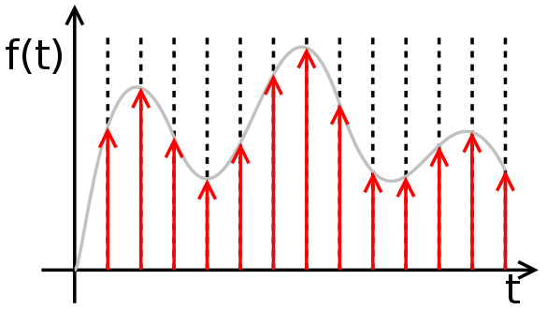
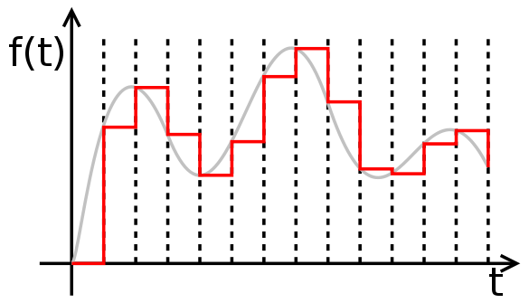
Zero-Order Hold
Zero-Order Hold describes the effect of converting a discrete-time signal to a continuous-time signal by holding each sample value for one sample interval

Slide 31
Reconstruction Filter
Both zero-order held steps and other output pulses, if unfiltered, would contain spurious high-frequency replicas of the original band-limited signal.
The reconstruction filter smooths the waveform to remove image frequencies above Nyquist limit.
The anti-aliasing filter and a reconstruction filter may be of identical design.

Slide 32
Q&A
Dr. Quang Duc Tran

Slide 33
Questions
What is band-limited signal?
What is the Nyquist sampling theorem? Provide a definition for the Nyquist frequency.
What is an anti-aliasing filter?
Define the meaning of the term “quantization interval” and how this influences the accuracy of the sampling process of an analogue signal.
Why does the quantization error gets worse with fewer bits to present an analogue signal?

